Slide 1

ASSETS TOKANIZATION AND TRAING
Tumelo Sebothoma
Bokang Lethamaga
Koketso Mopai
Sinenhlanhla Masuku
Sibusiso Ntuli
Neo Pilane
BY: GROUP 8

Slide 2
PROBLEM STATEMENT
The problem at hand revolves around high value assets not being easily converted to cash making them difficult to trade, and often lack clarity in ownership records.
And The problem is that owning and trading assets like property or art can be tough because it's often expensive, hard to sell quickly, and not very clear. We need a solution that makes it easier, like using a secure and clear platform where you can buy and sell pieces of assets, get help with rules, and make it easier for more people to join in.
E.g. Having no idea about the value of your asset.

Slide 3
SOLUTION
TokenizeIt platform aims to tokenize assets , enabling fractional ownership, and create a global, accessible marketplace. By doing so, it seemed to democratize assets ownership, promote financial inclusivity, enhance financial literacy, and ensure secure, transparent and compliant asset trading.
Due to the current exposure of 4th IR world, it is the right time for us because our product provide the current needs of our customers

Slide 4
How the product solves the problems?
Tokenizeit Will convert High value assets to
digital tokens on blockchain done by dividing
the value of the asset
Its uniqueness is that it enhances liquidity,accessibility
,allowing easy trade,fractional ownership and security
The name of the feature is Tokenize_It

Slide 5
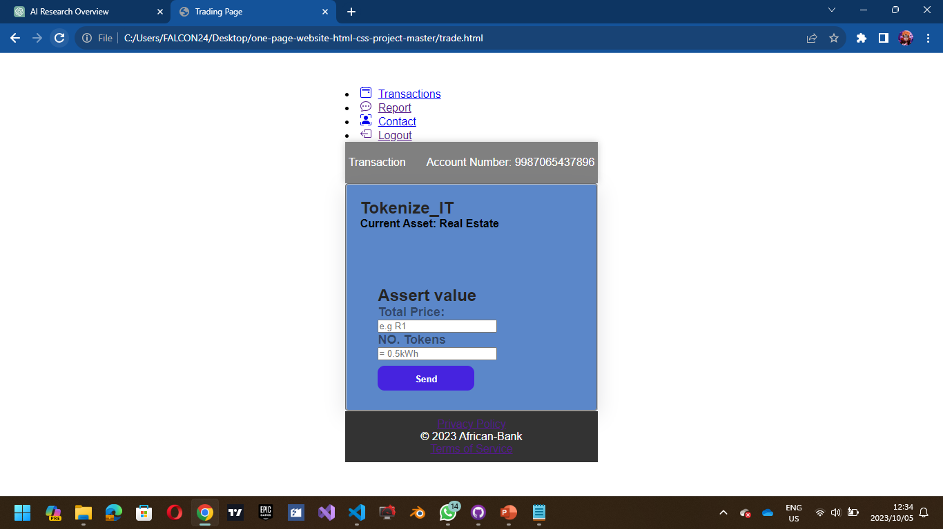
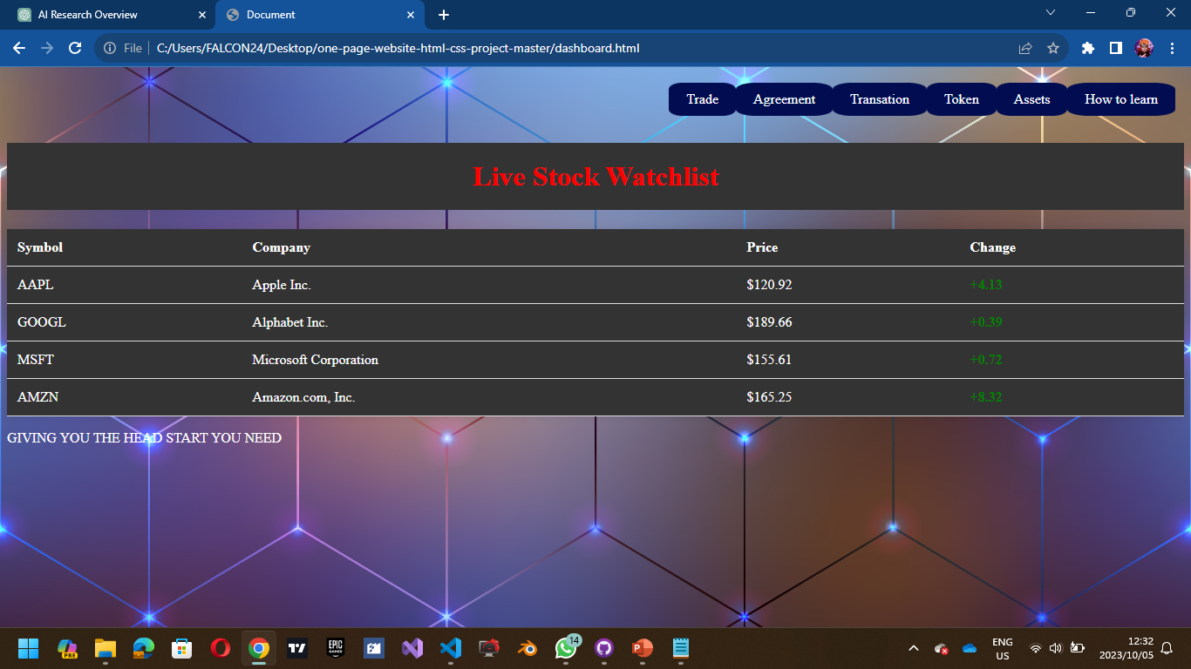

Slide 6
TARGET MARKETS
Banks And Investors
Financial Literacy individuals
All citizens
People who are Interested to stock trading and Investments

Slide 7
COMPETITORS
Capitec
Standard Bank
FNB
Traditional Financial Institutions

Slide 8
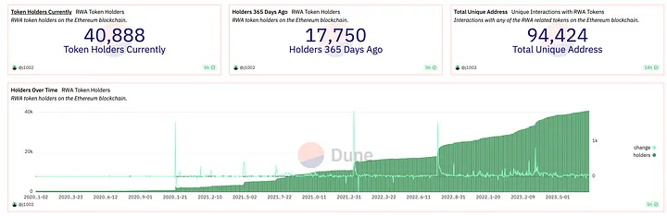
COMMERCIALASATION
 | Capitec
Compitator

Slide 9
Expects

